Slide 1
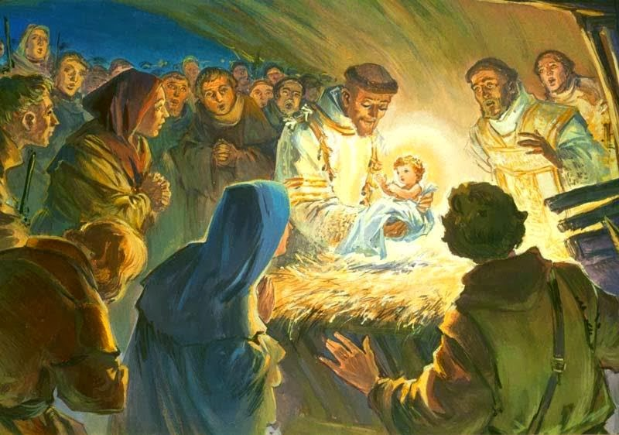

Slide 2
O come, O come Emmanuel
O come, O come Emmanuel,
And ransom captive Israel,
That mourns in lowly exile here,
Until the Son of God appear.
Refrain
Rejoice! Rejoice! O Israel,
To thee shall come Emmanuel.

Slide 3
Come thou dayspring, come and cheer
Our spirits by thine advent here.
Disperse the gloomy clouds of night,
And Death’s dark shadows put to flight.
Refrain
Rejoice! Rejoice! O Israel,
To thee shall come Emmanuel.

Slide 4
Luke 1:26-31
In the sixth month the angel Gabriel was sent by God to a town in Galilee called Nazareth, to a virgin betrothed to a man named Joseph, of the House of David; and the virgin’s name was Mary. He went in and said to her, “Rejoice, you who enjoy God’s favour! The Lord is with you. She was deeply disturbed by these words and asked herself what this greeting could mean, but the angel said to her, “Mary, do not be afraid; you have won God’s favour. Look! You are to conceive in your womb and bear a son, and you must name him Jesus.

Slide 5
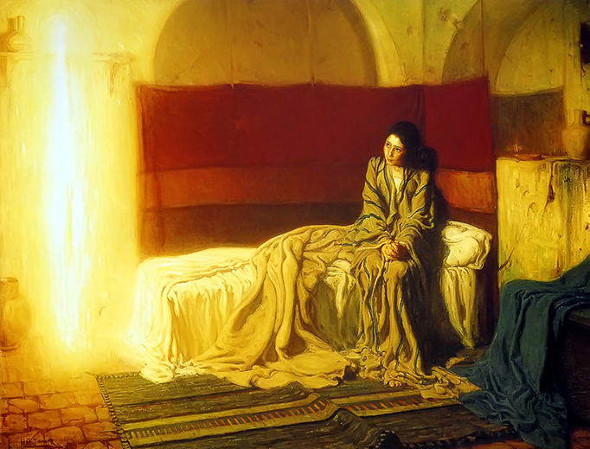

Slide 6
What Child Is This?
What child is this, who laid to rest,
On Mary’s lap is sleeping?
Whom angels greet with anthems sweet,
While shepherds watch are keeping?
Refrain
This, this is Christ the King,
Whom shepherds guard and angels sing:
Haste, haste to bring him laud,
The babe, the son of Mary.

Slide 7
Why lies he in such mean estate
Where ox and ass are feeding?
Good Christian fear: for sinners here
The silent Word is pleading.
Refrain
This, this is Christ the King,
Whom shepherds guard and angels sing:
Haste, haste to bring him laud,
The babe, the son of Mary.

Slide 8
Luke 2:1-7
Now it happened that at this time Caesar Augustus issued a decree that a census should be made of the whole inhabited world. This census – the first – took place while Quirinius was governor of Syria, and everyone went to be registered, each to his own town. So Joseph set out from the town of Nazareth, in Galilee for Judaea, to David’s town called Bethlehem, since he was of David’s house and line, in order to be registered together with Mary, his betrothed, who was with child. Now it happened that, while they were there, the time came for her to have her child, and she gave birth to a son, her first-born. She wrapped him in swaddling clothes and laid him in a manger because there was no room for them in the inn.

Slide 9
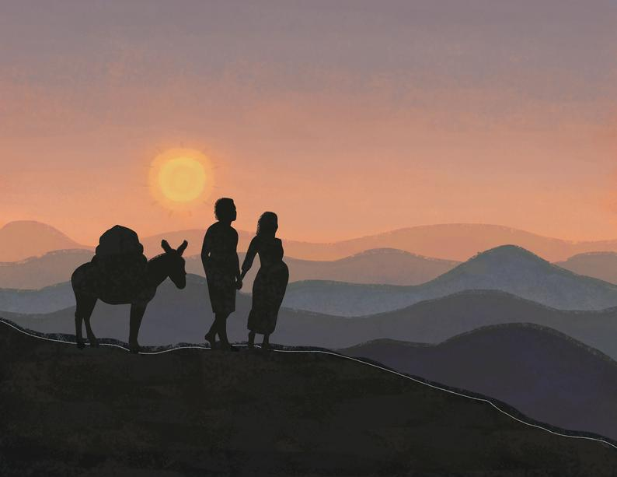

Slide 10
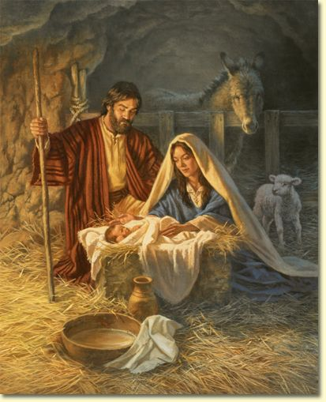

Slide 12
The Huron Carol
‘Twas in the moon of wintertime , when all the birds had fled,
That mighty Gitchi Manitou sent angel choirs instead.
Before their light the stars grew dim,
And wond’ring hunters heard the hymn:
Refrain
Jesus your King is born,
Jesus is born,
In excelsis gloria.

Slide 13
O children of the forest free, O Sons of Manitou
The holy child of earth and heav’n Is born today for you.
Come kneel before the radiant boy,
Who brings you beauty, peace and joy:
Refrain
Jesus your King is born,
Jesus is born,
In excelsis gloria.

Slide 14
Luke 2: 8-13
In the countryside, close by there were shepherds out in the fields keeping guard over their sheep during the watches of the night. An angel of the Lord stood over them and the glory of the Lord shone round them. They were terrified, but the angel said, “Do not be afraid. Look, I bring you news of great joy, a joy to be shared by the whole people. Today in the town of David a saviour has been born to you; he is Christ the Lord. And here is a sign for you: you will find a baby wrapped in swaddling clothes and lying in a manger. And all at once with the angel there was a great throng of the hosts of heaven, praising God…..

Slide 15
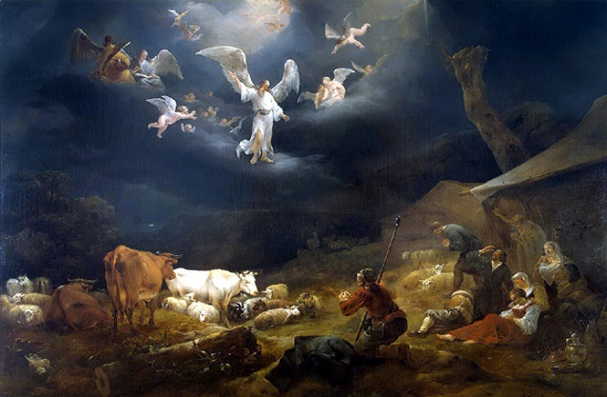

Slide 16
The First Nowell
The first Nowell the angel did say
Was to certain poor shepherds in fields as they lay;
In fields where they lay keeping their sheep,
On a cold winter’s night that was so deep.
Refrain
Nowell, Nowell, Nowell, Nowell
Born is the King of Israel.
Nowell, Nowell, Nowell, Nowell
Born is the King of Israel.

Slide 17
They looked up and saw a star
Shining in the east, beyond them far,
And to the earth it gave great light,
And so it continued both day and night.
Refrain
Nowell, Nowell, Nowell, Nowell
Born is the King of Israel.
Nowell, Nowell, Nowell, Nowell
Born is the King of Israel.

Slide 18
Luke 2:15-18
Now it happened that when the angels had gone from them into heaven, the shepherds said to one another, “Let us go to Bethlehem and see this event which the Lord has made known to us.” So they hurried away and found Mary and Joseph, and the baby lying in the manger. When they saw the child they repeated what they had been told about him, and everyone who heard it was astonished at what the shepherds said to them.

Slide 19
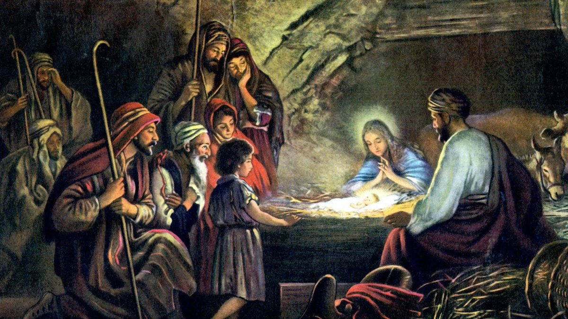

Slide 20
Come, All Ye Faithful
O come, all ye faithful, joyful and triumphant,
O come ye, o come ye to Bethlehem;
Come and behold him born the King of angels:
O come let us adore Him, O come let us adore Him,
O come let us adore Him, Christ the Lord.
Sing, choirs of angels, sing in exultation,
Sing all ye citizens of heav’n above.
Glory to God in the highest:
O come let us adore Him, O come let us adore Him,
O come let us adore Him, Christ the Lord.

Slide 21
Luke 2: 19-20
As for Mary, she treasured all these things and pondered them in her heart. And the shepherds went back glorifying and praising God for all they had heard and seen, just as they had been told.

Slide 22
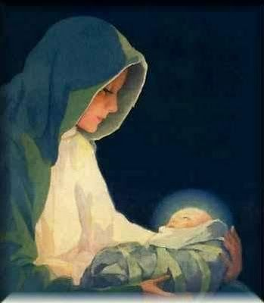

Slide 23
Joy to the World
Joy to the world! The Lord is come:
Let earth receive her King:
Let every heart prepare Him room.
And heav’n and nature sing,
And heav’n and nature sing,
And heav’n and heav’n and nature sing.

Slide 24
Joy to the world! the Saviour reigns;
Let men their songs employ,
While fields and floods, rocks, hills and plains
Repeat the sounding joy,
Repeat the sounding joy,
Repeat, repeat the sounding joy.

Slide 25
Matthew 2: 1-2, 9-11
After Jesus had been born at Bethlehem in Judaea during the reign of King Herod, suddenly some wise men came to Jerusalem from the east asking, “Where is the infant king of the Jews? We saw his star as it rose and have come to do him homage.” …Having listened to what the king had to say, they set out. And suddenly the star they had seen rising went forward and halted over the place where the child was. The sight of the star filled them with delight, and going into the house they saw the child with his mother Mary, and falling to their knees they did him homage. Then, opening their treasures, they offered him gifts of gold and frankincense and myrrh.

Slide 26
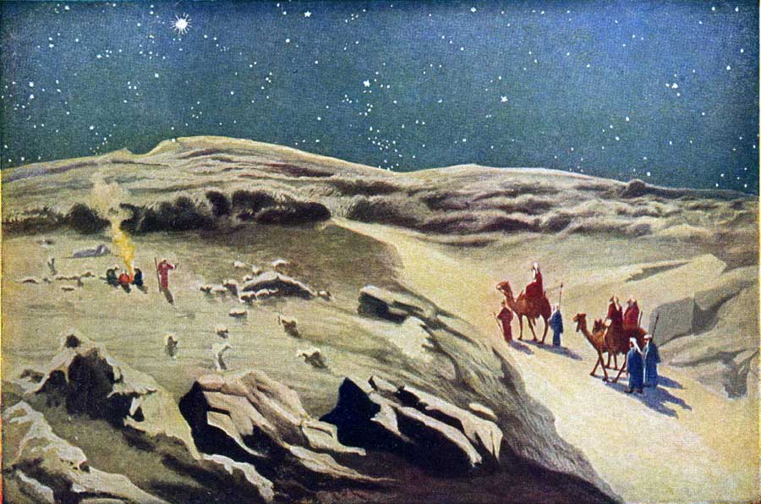

Slide 27
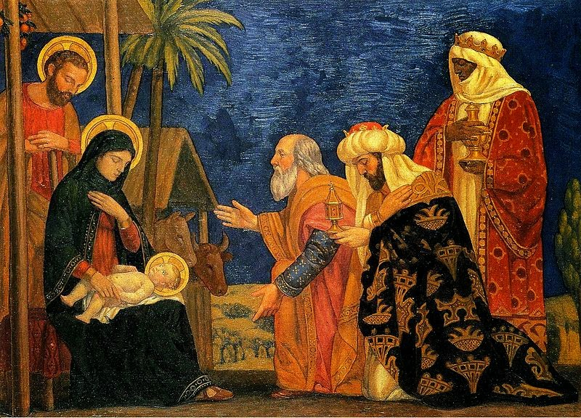

Slide 28
We Three Kings of Orient Are
We three kings of Orient are
Bearing gifts we traverse afar.
Field and fountain, moor and mountain,
Following yonder star.
Refrain
Star of wonder, star of night.
Star with royal beauty bright.
Westward leading, still proceeding,
Guide us to thy perfect light.

Slide 29
Born a King on Bethlehem’s plain,
Gold I bring to crown Him again,
King forever, ceasing never,
Over us all to reign.
Refrain
Star of wonder, star of night.
Star with royal beauty bright.
Westward leading, still proceeding,
Guide us to thy perfect light.

Slide 30
Silent Night
Silent night! Holy night!
All is calm, all is bright;
Round yon virgin mother and child,
Holy infant so tender and mild,
Sleep in heavenly peace,
Sleep in heavenly peace.

Slide 31
Silent night! Holy night!
Shepherds quake at the sight:
Glories stream from heaven afar,
Heav’nly hosts sing Alleluia.
Christ the Saviour is born!
Christ the Saviour is born!

Slide 32
